Slide 1
Determinants of the Attitude toward Political Parties in Palestine
IPSA 22nd World Congress, Madrid, July 10, 2012
Panel: Contemporary Middle East from the Perspective of Religion and Politics
The Effect of the Egyptian Revolution on the Adherents of Fatah and Hamas
HAMANAKA Shingo
Yamagata University, Japan

Slide 2
A well-known phenomenon
Introduction
Data & Methods
Analysis
Discussion
“If democratization brought out in the Middle East, Islamic parties would gain power in the elections.”
Hizbullah (Lebanon)
The Shiite Islamic party alliance (Iraq)
Hamas (Palestine in 2006)
Ennahda movement (Tunisia)
Freedom & Justice Party (Egypt)
Justice & Development Party (Morocco)

Slide 3
What is the impact of the Arab Spring for the Palestinians?
Introduction
Data & Methods
Analysis
Discussion
The revolution changed the Egyptian policy regarding Palestine.
“the victory of the Egyptian revolution was the shortest way to the liberation of the Palestinians” [Atwan 2011]
We focus on Palestinian political attitudes in the wave of the Arab Spring.

Slide 4
Explanation of data and methods
Introduction
Data & Methods
Analysis
Discussion
Two waves of poll data were collected in 2009 and 2011, before and after the Arab Spring.
A simple statistical comparison of approval ratings for Fatah and Hamas
To identify the determinants, we employ logistic and OLS regressions.

Slide 5
Meeting and Field Work
Introduction
Data & Methods
Analysis
Discussion

Slide 6
Hypothesis and Alternative
Introduction
Data & Methods
Analysis
Discussion
Hypothesis
The Arab Spring movement changed the views of the adherents of Hamas and Fatah. The evaluation of Egyptian diplomacy has increased by the Arab Spring, and is a determinant of the popularity of Hamas

Slide 7
Hypothesis and Alternative
Introduction
Data & Methods
Analysis
Discussion
Alternative Hypothesis
The Arab Spring movement had no effect on the approval ratings for the Palestinian parties. The electorate judges parties in accordance with their performance.

Slide 8
Findings: Descriptive Statistics
Introduction
Data & Methods
Analysis
Discussion
Table 1. Palestinian ratings of voting for Hamas and Fatah
*p<.05, **p<.01, ***p<.001, two-tailed χ²- test
 | May 2009 | June 2011
HAMAS | 19.0% | 13.9% | **
Fatah | 32.5% | 36.3%

Slide 9
Findings: Descriptive Statistics
Introduction
Data & Methods
Analysis
Discussion
Table 2. Ratings of voting for Hamas in Gaza and of Fatah in the WB
*p<.05, **p<.01, ***p<.001, two-tailed χ²- test
 | May 2009 | June 2011
HAMAS in Gaza | 26.1% | 21.4%
Fatah in the West Bank | 33.3% | 45.1% | ***

Slide 10
Findings: Descriptive Statistics
Introduction
Data & Methods
Analysis
Discussion
Figure 1 Evaluation of Egyptian diplomacy for regional stability (%)

Slide 11
Ordered Logit Models (1 & 2)
Introduction
Data & Methods
Analysis
Discussion
Dependent variable
Pattern of voting behavior
(1) Hamas (2) no vote (3) Fatah
Independent variable
Evaluation of Egyptian diplomacy
Control variables
Sustainable solutions for the conflict
Evaluation of other countries' diplomacy

Slide 12
Table 3. Effect of assessment of Egyptian diplomacy on voting for and party identification of Hamas and Fatah
Introduction
Data & Methods
Analysis
Discussion
 | Model 1 | Model 2 | Model 3 | Model 4
estimation (dependent variable) | Ordered Logit (voting 2009) | Ordered Logit (voting 2011) | OLS (Hamas) 2011 | OLS (Fatah) 2011
Egypt | 0.197 | 0.018 | 0.071 | 0.562
 | (2.17)* | (0.25) | (0.38) | (4.33)**
independent in the 1967 land | 0.856 | 0.632 | -0.365 | 0.639
 | (3.57)** | (3.86)** | (1.05) | (2.03)*
independent in historical Palestine | -0.612 | -0.189 | 0.198 | 0.111
 | (2.27)* | (1.02) | (0.45) | (0.35)
reconciliation of factions | 0.419 | -0.436 | 0.921 | 0.216
 | (2.06)* | (1.76) | (1.62) | (0.50)
abandonment of armed resistance | 0.569 | -0.070 | -0.601 | 0.304
 | (2.50)* | (0.46) | (1.44) | (1.15)
United States | 0.094 | 0.105 | -0.396 | -0.296
 | (1.33) | (2.08)* | (3.12)** | (3.35)**
Jordan | 0.051 | 0.278 | -0.079 | 0.107
 | (0.52) | (3.91)** | (0.44) | (0.86)
Turkey | -0.024 | 0.006 | -0.249 | -0.320
 | (0.28) | (0.10) | (1.68) | (2.71)**
Iran | -0.389 | -0.259 | 0.523 | -0.131
 | (4.87)** | (3.94)** | (3.39)** | (1.11)
Syria | -0.090 | -0.258 | 0.920 | -0.125
 | (0.95) | (3.81)** | (5.50)** | (1.08)
Saudi Arabia | 0.060 | 0.160 | -0.159 | 0.310
 | (0.63) | (2.35)* | (0.90) | (2.66)**
R² |  |  | 0.16 | 0.11
N | 537 | 1,039 | 503 | 589

Slide 13
Regression Models (3 & 4)
Introduction
Data & Methods
Analysis
Discussion
Dependent variable
Emotional Thermometer of Hamas (Model 3)
Emotional Thermometer of Fatah (Model 4)
Independent variable
Evaluation of Egyptian diplomacy
Control variables
Sustainable solutions for the conflict
Evaluation of other countries' diplomacy

Slide 14
Table 3. Effect of assessment of Egyptian diplomacy on voting for and party identification of Hamas and Fatah
Introduction
Data & Methods
Analysis
Discussion
 | Model 1 | Model 2 | Model 3 | Model 4
estimation (dependent variable) | Ordered Logit (voting 2009) | Ordered Logit (voting 2011) | OLS (Hamas) 2011 | OLS (Fatah) 2011
Egypt | 0.197 | 0.018 | 0.071 | 0.562
 | (2.17)* | (0.25) | (0.38) | (4.33)**
independent in the 1967 land | 0.856 | 0.632 | -0.365 | 0.639
 | (3.57)** | (3.86)** | (1.05) | (2.03)*
independent in historical Palestine | -0.612 | -0.189 | 0.198 | 0.111
 | (2.27)* | (1.02) | (0.45) | (0.35)
reconciliation of factions | 0.419 | -0.436 | 0.921 | 0.216
 | (2.06)* | (1.76) | (1.62) | (0.50)
abandonment of armed resistance | 0.569 | -0.070 | -0.601 | 0.304
 | (2.50)* | (0.46) | (1.44) | (1.15)
United States | 0.094 | 0.105 | -0.396 | -0.296
 | (1.33) | (2.08)* | (3.12)** | (3.35)**
Jordan | 0.051 | 0.278 | -0.079 | 0.107
 | (0.52) | (3.91)** | (0.44) | (0.86)
Turkey | -0.024 | 0.006 | -0.249 | -0.320
 | (0.28) | (0.10) | (1.68) | (2.71)**
Iran | -0.389 | -0.259 | 0.523 | -0.131
 | (4.87)** | (3.94)** | (3.39)** | (1.11)
Syria | -0.090 | -0.258 | 0.920 | -0.125
 | (0.95) | (3.81)** | (5.50)** | (1.08)
Saudi Arabia | 0.060 | 0.160 | -0.159 | 0.310
 | (0.63) | (2.35)* | (0.90) | (2.66)**
R² |  |  | 0.16 | 0.11
N | 537 | 1,039 | 503 | 589

Slide 15
Probability of voting for Hamas decreases with more favorable Egypt
Introduction
Data & Methods
Analysis
Discussion
Figure 2 Change in the Probability of voting for Hamas by Egypt Evaluation from the estimation in 2009

Slide 16
Table 3. Effect of assessment of Egyptian diplomacy on voting for and party identification of Hamas and Fatah
Introduction
Data & Methods
Analysis
Discussion
 | Model 1 | Model 2 | Model 3 | Model 4
estimation (dependent variable) | Ordered Logit (voting 2009) | Ordered Logit (voting 2011) | OLS (Hamas) 2011 | OLS (Fatah) 2011
Egypt | 0.197 | 0.018 | 0.071 | 0.562
 | (2.17)* | (0.25) | (0.38) | (4.33)**
independent in the 1967 land | 0.856 | 0.632 | -0.365 | 0.639
 | (3.57)** | (3.86)** | (1.05) | (2.03)*
independent in historical Palestine | -0.612 | -0.189 | 0.198 | 0.111
 | (2.27)* | (1.02) | (0.45) | (0.35)
reconciliation of factions | 0.419 | -0.436 | 0.921 | 0.216
 | (2.06)* | (1.76) | (1.62) | (0.50)
abandonment of armed resistance | 0.569 | -0.070 | -0.601 | 0.304
 | (2.50)* | (0.46) | (1.44) | (1.15)
United States | 0.094 | 0.105 | -0.396 | -0.296
 | (1.33) | (2.08)* | (3.12)** | (3.35)**
Jordan | 0.051 | 0.278 | -0.079 | 0.107
 | (0.52) | (3.91)** | (0.44) | (0.86)
Turkey | -0.024 | 0.006 | -0.249 | -0.320
 | (0.28) | (0.10) | (1.68) | (2.71)**
Iran | -0.389 | -0.259 | 0.523 | -0.131
 | (4.87)** | (3.94)** | (3.39)** | (1.11)
Syria | -0.090 | -0.258 | 0.920 | -0.125
 | (0.95) | (3.81)** | (5.50)** | (1.08)
Saudi Arabia | 0.060 | 0.160 | -0.159 | 0.310
 | (0.63) | (2.35)* | (0.90) | (2.66)**
R² |  |  | 0.16 | 0.11
N | 537 | 1,039 | 503 | 589

Slide 17
What’s the influence of the Arab Spring?
Introduction
Data & Methods
Analysis
Discussion
The alternative hypothesis is accepted.
The Arab Spring had no effect on the approval ratings for the Palestinian parties. The electorate makes a judgment of parties in accordance with their performance.

Slide 18
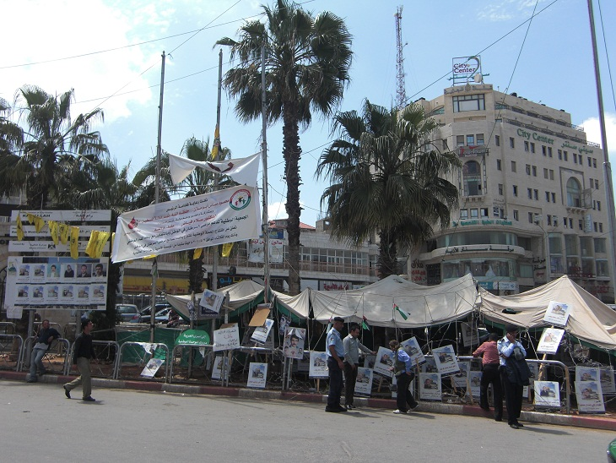
Thank you.

