Slide 1
Foreign Affairs, the National Interest, and Secular-Religious Identities in Israel
RC43.224: Religion, International Relations, and Foreign Policy
HAMANAKA, Shingo, Ph.D.
Yamagata University, Japan
Introduction
Data & Methods
Analysis
Discussion
Notes:
As you can see, I am a Japanese political scientist, but my topic is not about Japan. My talk is about Israel.
You may think why a Japanese researcher studies Israeli politics. The reason is associated with war and peace.
Japan has never been involved in a war after the World War II. Japanese people have enjoyed safety daily time more than 68 years.
Therefore, I am interested in conditions of peace in decision of my major: international politics and comparative politics.
I chose Israel as a case to examine a mechanism of international conflict.
The heartbreaking situation continues over a week in the name of Operation Protective Edge.
It is a good opportunity to think about conditions of peace in the case of Israel.

Slide 2
Introduction: Foreign Affairs and People
Introduction
Data & Methods
Analysis
Discussion
Are ordinary citizens able to consider the national interest to evaluate foreign policies?
Most realists are elitists, but some constructivists seriously treat with the national interest and people’s identity.
Notes:
Modern democracies contain a core to convert the will of the people into public policy in the form of legislation via national elections.
However, specialists of diplomacy criticized the effect of public opinion on foreign policy.
Then, are ordinary citizens able to consider the national interest in order to evaluate foreign policies?
We start to investigate Hans Morgenthau’s famous definition of national interest, the concept of interest defined in terms of power.
It is not an easy task even for professionals to examine how much power a state has.
Some constructivists, such as Martha Finnemore, proposes national norms defining state interests.
A constructivist hypothesis suggests the notion of national interest varies according to the content of a collective identity in a society.
If this were true, the structure of social cleavages between different identities would produce multiple national interests in a society.

Slide 3
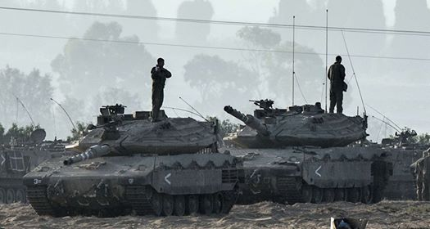
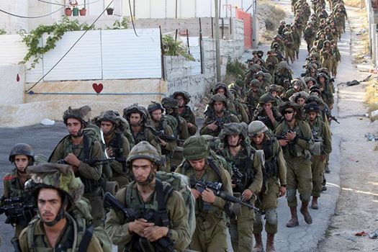
Introduction: Why Israel?
Introduction
Data & Methods
Analysis
Discussion
Majority research has been conducted in the United States.
Israelis are more serious in considering the risk of foreign policy options.
Notes:
The majority of empirical research on the link between foreign policy and public opinion has been conducted in the United States, and several studies in European countries. If a small democratic country faces an international crisis, the conscript risk affects a greater portion of citizens than in larger countries. The citizens in the small country are more serious in considering the risk of foreign policy options under crises.
In this paper, we examine the effect of religious belief on attitudes toward foreign policy in the case of a small democratic country, with a strong collective identity: the state of Israel. On the one hand, the Israelis have a collective identity, Judaism, and have practiced democracy for more than sixty years. On the other hand, Israel suffers from a secular-religious cleavage within Judaism.
The rift over collective identity often brings about severe political disputes on national integrity. The issue about the occupied territories is one of the most contentious over ideologies, national security, and religious devotion. As several studies recognize, it remains unclear how to explain theoretically the mechanisms through which religious beliefs influence foreign and security policy . This study tries to discover the missing link between religious identities and foreign policy.

Slide 4
Introduction: Theory
Introduction
Data & Methods
Analysis
Discussion
Kant: Republican Perpetual Peace
Notes:
For a few centuries, no significant advances have been made in the normative theory about public opinion on foreign policy in democracies, with a few exceptions.
Emmanuel Kant presents a comprehensive understanding of the topic: Republican Perpetual Peace, the people in democratic countries are sensitive to the risk of war.
Today, his argument is the basis for research on democratic peace.
Democratic peace studies developed the theoretical concept of domestic audience costs for the micro-foundation.
The audience costs hypothesis is empirically supported by a few experimental survey studies, which represent a type of dealing with the link between diplomacy and public opinion.
The argument may be suitable for large countries, such as the United States, European countries, and Japan. However, it is not appropriate for a small democratic country such as Israel because of its sensitivity to damage and the burden of war. The case of Israel is better suited for Kant’s theory.

Slide 5
Introduction: Theory
Introduction
Data & Methods
Analysis
Discussion
Zionism: Foundation of the State
to escape the domination of the gentile
Middle East war-proneness(Miller 2008)
the state-to-nation imbalance
a lack of congruence between the states and national identifications
Notes:
Israel is established on Zionism as the foundation of the state, so we can regard every behavior, activity, and policy in line with Zionism as in the national interest. The founding fathers of Israel sought to preserve the existence of Jews and selected the route of building a nation-state to escape the domination of the gentile. Zionists argue that their understanding of the world is similar to that of the realists in international relations. Zionism, meanwhile, is connected to the fundamental concepts of Judaism and inseparable from the Promised Land, which is one of the important territorial concepts.
Successive Israeli governments have considered the concept of land for peace, a conflict resolution produced by strategic thinking in the territories. Consequently, land for peace is a possible option in international relations realist thinking, but it is incompatible with the principles of religious Zionism, which regards the Promised Land as containing all of the areas of the West Bank as an indivisible part of its territory. The incompatibility resembles Benjamin Miller’s argument exploring the cause of regional conflict and peace. Miller demonstrates that the determinant of war-proneness is the state-to-nation imbalance, which means a lack of congruence between the states and national identifications. We should investigate public opinions in Middle Eastern countries in order to test Miller’s state-to-nation balance theory.

Slide 6
Hypothesis
Secular-religious identities, or the religiosity of Judaism, will significantly predict attitudes toward future options and past achievements in Israeli foreign and security affairs as well as various territorial compromises from the viewpoint of the national interest.
Notes:
Asher Arian, the most comprehensive analyst of survey datasets about Israeli attitudes toward national security, invokes religiosity, a major social cleavage, to examine the link between religious identification and political issues such as a return of the occupied territories. The religious-secular divide correlates statistically with Jewish attitudes toward the use of force in Barzilai and Inbar. Yuchtman-Ya’ar and Peres demonstrates that secularism is the most influential factor in determining people’s attitude toward tolerance, the preference of democracy over nationalism, trust in public institutions, and position on the dovish-hawkish continuum in the Arab-Israel conflict.
The religious-secular divide is also statistically significant in explaining the variance of xenophobia, that is, attitudes of fear or hatred directed toward certain groups in. The empirical findings of the democratic performance evaluation suggest that religiosity is strongly correlated with prejudice, political intolerance, and undemocratic norms. The above review leads us to expect:
Secular-religious identities, or the religiosity of Judaism, will significantly predict attitudes toward future options and past achievements in Israeli foreign and security affairs as well as various territorial compromises from the viewpoint of the national interest.

Slide 7
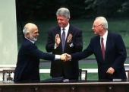
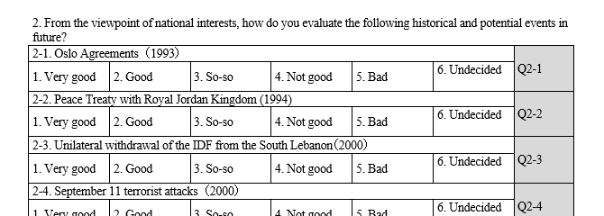
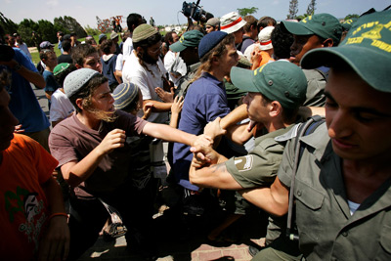
Data and Measurement
Introduction
Data & Methods
Analysis
Discussion
Original Survey conducted phone interviews in fall 2011
n=680; Jewish citizens
Evaluations of peace policies
Notes:
To assess the impact of religiosity on evaluations of past and future security policies, we compare evaluations of secular and non-secular Jews in Israel.
The data for this study come from the Israel Poll of the Middle Eastern Public Opinion Research Project. The survey data were collected during fall 2011 by the Dahaf research institute, which conducted phone interviews in Hebrew and Russian with a representative national sample of the 18 years and older Jewish population.
A sample of 680 Jewish citizens was drawn using strata defined by demographic sector, or immigrants from the former Soviet Union, religiosity, characteristics of residential neighborhoods, and gender. One in five Israelis came from the former Soviet Union (21%) and more than half of the citizens identified themselves as secular (52%). The author and my collaborators prepared survey questionnaires to measure assessments of peace and war policies as well as the changing international environment.
The category of peace policy in our dataset contains the Oslo Accord, the Peace Treaty with Jordan, the withdrawal from South Lebanon, and the demolition of settlements in the Gaza Strip. Our measurement device is the Likert type scale of 5 points evaluation of public policies.

Slide 8
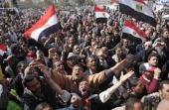
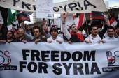
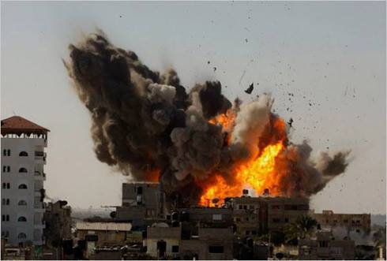
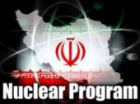
Data and Measurement
Introduction
Data & Methods
Analysis
Discussion
Evaluations of War policies
Changing Regional Environment
Future Crisis and Unresolved Issues
Notes:
The state of Israel carried out three military campaigns in the first decade of the millennium: Operation Defensive Shield in 2002, the Second Lebanon War in 2006, and Operation Cast Lead during 2008-9. Since 2000, the Middle East has changed, and it seems to have had some effect on Israeli foreign policy. The Bush administration launched the Iraq War in the spring of 2003. It is unclear whether the Egyptian uprising, the January 25 revolution in 2011, produced a safer environment for the state of Israel, because of the confusing diplomatic stance of the Mursi administration at that time. The Arab Spring spilt over, but induced a severe and endless war between Bashar al-Asad and Syrian dissidents. The situation is also unclear for Israel.
The state of Israel faces several unfolding issues; some of them carry risk, and others are a threat to national security in the future. The most sensitive issue is the construction of the settlements in the West Bank. Iran’s nuclear program is the most serious concern about the Israeli national security. The Israeli political leadership has campaigned to alert the danger of Iran’s ambition to develop a nuclear weapon and threaten to destroy the existence of the Jewish state. It is widely recognized that the largest obstacle to peace is the continuing occupations in the West Bank. The substance of the Israel-Palestinian conflict is concerned with to what extent are Israelis able to compromise on the territories.

Slide 9
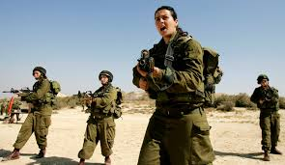
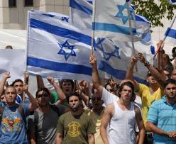
Religiosity: secular-religious divide
Introduction
Data & Methods
Analysis
Discussion
Notes:
In the field of Israeli sociology, religious identification or religiosity in Judaism falls into four categories: Ultra-Orthodox, religious, traditional, and secular.
Secular citizens have different lifestyles from the non-secular.
They are almost half the population in Israel and are establishments in politics, judicial circles, and the army.
Israeli secular identity is widely regarded as non-observant of religious law or Halakhah and is associated with emptiness by non-secular Jews.
The religious-secular dichotomy is a useful concept for analyzing contemporary Israeli society.

Slide 10
Empirical Strategy - Propensity Score Matching-
Introduction
Data & Methods
Analysis
Discussion
Evaluation of policies
(Outcome)
Covariates
Party Identification
Ethnicity
Education
Expenditure
Sex
confounding
Religiosity
(treatment)
Notes:
This is an illustration of a simple confounding case: in this graphical model, we want to find association between religiosity and evaluation of policies.
When there are covariates associate with both religiosity and policy evaluations, it is difficult to find true correlation between treatment and outcome with a statistical test.
We have to remove confounding factors from the model, but how to do it?

Slide 11
Empirical Strategy - Standard Technic: Logit Model-
Introduction
Data & Methods
Analysis
Discussion
Evaluation of policies
(dependent variable)
Religiosity
(independent variable)
countless combinations of interaction terms
dimensional curse
PI × Ethnicity
PI × Ethnicity × Education
PI × Education
PI × Education × Expenditure
Education × Expenditure
Sex × Education × Expenditure
………………………………
(Control)
Party Identification
Ethnicity
Education
Expenditure
Sex
Notes:
A well-known technic is to insert covariates as some control variables into a regression model.
If the dependent variable is binary, we use logistic regression or probit regression model.
Once we decide to treat with religiosity as the independent variable, covariates would be the control terms in the model.
This solution makes sense statistically and it is easy in manipulation, but it remains a serious problem.
This is about interaction terms. If a control term is not significant, some combinations of a few control variables may be significant to explain the variance of the dependent variable.
When we overlook the interaction terms, they would produce a biased estimation not in considering a vital part of the interaction terms.
This problem is difficult because of countless combinations in thinking about the interaction. It is so called dimensional curse.

Slide 12
Empirical Strategy - Propensity Score Matching-
Introduction
Data & Methods
Analysis
Discussion
Covariates
Party Identification
Ethnicity
Education
Expenditure
Sex
Religiosity
(treatment)
Average Treatment Effect (ATE)
Propensity Score
PS is estimated probability by probit analysis.
PSM produces similar demographic two groups without religiosity.
Evaluation of policies
(Outcome)
Notes:
Technically, researchers create a single variable; a propensity score that captures how differences in these covariates contribute to a person’s probability of categorizing secular versus non-secular group.
They use this propensity score to create groups of secular versus non-secular people that look similar to each other.
Then, researchers compare outcomes, evaluation of foreign and security policies between these groups of well-matched persons.

Slide 13
Introduction
Data & Methods
Analysis
Discussion
Notes:
This figure shows a part of the result estimations of average treatment effects (ATE) on the ordered categorical dependent variable, with a bias-corrected 95 percent confidence interval obtained by the Kernel matching method using the bootstrap option; in compared with the differences in the means between secular and non-secular groups; the coefficients on secularism in the ordered logit models.
The ATE of secularism passes the 5 percent significance level on evaluations of Operation Defensive Shield in 2002, here.
We know secular Israelis assess Operation Defensive Shield—the largest military operation in the West Bank since the Six-Day War—at an average 0.358 points lower than religious Jews.

Slide 14
Introduction
Data & Methods
Analysis
Discussion
Notes:
This figure shows another part of the result.
We find the ATE of secularism passes the 5 percent significance level on evaluations of enlargement of settlements, the independence of a Palestinian state, and compromise treatment with the occupied territories on the principle of land for peace.
The secular evaluation of settlement enlargement in the West Bank is calculated 0.727 points lower than the religious group’s evaluation.
Secularists give 0.463 points of additional support to a future independent Palestinian state compared with the religious.
The land for peace settlement is given a 0.432-point positive assessment by secular citizens.
The ordered logit models for these events also provide significant regressors, but the effects of secular-religious identities here are overestimated compared with the values of the ATE.

Slide 15
Result
Introduction
Data & Methods
Analysis
Discussion
The secular-religious divide is a significant factor only in public opinion on war operations or territorial compromises.
The PSM method reduces the bias in the impact of Jewish religiosity.

Slide 16
Discussion
Introduction
Data & Methods
Analysis
Discussion
The national interest is not defined in the strategic calculation but is determined by a collective national identity.
Religion is an influential source of collective identity; it often promotes intractable conflicts over territory.
Notes:
In conclusion, we suggest a theoretical implication for foreign affairs and public opinion in democratic countries.
When a disputed region is associated with the essence of a nation, the national interest is not defined in the strategic calculation of political leaders but is determined by a collective national identity.
A forceful approach to the resolution of the territorial dispute will lead to a clash of social identities among the people and then serious reconsideration of the configuration of the nation-state.
It is almost impossible because there is a high risk to national integrity in this reconsideration.
Religion is an influential source of collective national identity; therefore, it often promotes intractable conflicts over territory.

Slide 17
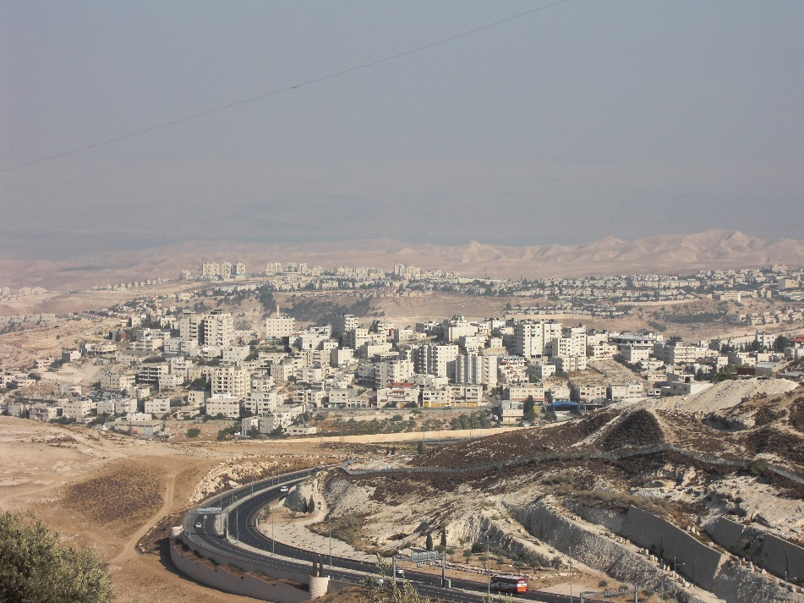
Thank you

