Slide 1
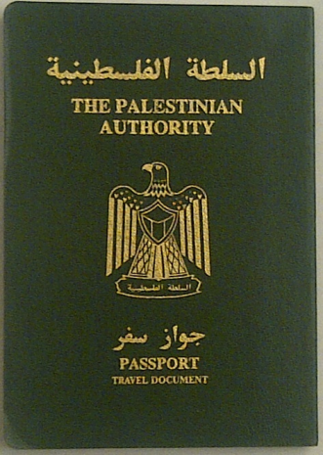
Palestinian Migration under the occupation
12th International Conference: " Migration and Democracy”, Centre de Documentation sur les Migrations Humaines
14 June 2012, Rathaus der Stadt Düdelingen, Luxembourg
Comparative study about the residents of the West Bank, Gaza Strip, and East Jerusalem
NISHIKIDA Aiko, Tokyo University of Foreign Studies
HAMANAKA Shingo, Yamagata University

Slide 2
Purpose of the study
To clarify the current situation of the Palestinian migration
To investigate how their migration is influenced by the Israeli distinctive democracy and its stratified citizenship
To explore relationship between migration and citizenship under occupation

Slide 3
Democracy and citizenship in Israel
Independence and democracy declared in 1948
Original dilemma: “a Jewish and democratic state” derived from Zionism
More than 1.5 million of non-Jewish residents (25 % of the population)

Slide 4
Overview of the research
Poll survey conducted in July 211 in cooperation with JMCC (Jerusalem Media and Communication Centre)
Research fund by KAKENHI, Grant-in-Aid for Young Scientists (A) No. 23681052 sponsored by the Ministry of Education , Culture, Sports, Science and Technology (MEXT) in Japan
Representative sample from 18 to 65 years old in the West Bank, Gaza Strip and East Jerusalem

Slide 5
Figure 1. Destination of the Palestinian emigration (%)

Slide 6
Reasons of migration
Purpose-based reason
Exodus incurred by Israeli occupation
Daily moves inside the West Bank, Gaza Strip and Occupied Palestine
Resource-based reason
Restriction of movement
Economic condition

Slide 7
Table 1. Emigrants by Destination and Reasons (Desire)
 | Higher Income | Skill Develop | Family Network | Cultural Similarity | Easy Immigre
Palestine | ◎ | ◎ | 〇 | ◎ | △
Gulf States | ◎ | ◎ | 〇 | ◎ | △
Jordan | 〇 | 〇 | ◎ | ◎ | ◎
Egypt | △ | ◎ | ◎ | ◎ | △
United States | ◎ | ◎ | △ | △ | △
(Notes) △: ～40%, 〇:40～50%, ◎:50%～

Slide 8
Table 2. Emigrants by Destination and Reasons (Experience)
 | Higher Income | Family Network | Cultural Similarity | Past Living
Palestine | 〇 | ◎ | ◎ | △
Gulf States | ◎ | ◎ | 〇 | 〇
Jordan | ◎ | ◎ | ◎ | ◎
Egypt | △ | ◎ | ◎ | ◎
United States | ◎ | ◎ | △ | △
(Notes) △: ～40%, 〇:40～50%, ◎:50%～

Slide 9
Figure 2. ID type of the Palestinians

Slide 10
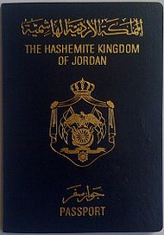
Figure 3. Passport Type of the Palestinians

Slide 11
Table 6 Figure 4. Distribution of Stayed Countries by Passport type (%)
χ2=53.237, DF=3, p<.001.
the Kruskal-Wallis Test to reject the null hypothesis that there is no linkage between groups (p<.0001)

Slide 12
Figure 5. Distribution of Stayed Countries by districts

Slide 13
Stratified citizenship
Different statuses for migration – result of the stratified citizenship
Alternative policy for non-Jewish minority in Israel
Residents of the Occupied Territories and East Jerusalem – non citizens, but with actual citizenship in Israeli political system

Slide 14
Conclusion
Stratified citizenship reflects Israeli unique democracy
Difficulty of migration for Palestinians – limited resources
Palestinians as active migrants – migration as strategy of living
Citizenship as a divide-and-conquer strategy of minorities

